Slide 1

FEEDBACK MANAGEMENT SYSTEM
Presented By —
Arpan Pal
Joysurjya Bera
Neha Upadhyay
Pushpanjali Kumari
Sneha Chakroborty

Slide 2
PROBLEM STATEMENT
Feedback Management System should provide the ability for :
Admin
To maintain the skill set of trainers
To maintain the training courses
To view feedback reports and defaulters
Coordinator
To apply CRUD operations on training programs
To view feedback reports and defaulters
Participant
To give feedbacks for the training programs

Slide 3
COMPONENTS USED
The components used in this project are —
Core Java 8
Spring, JPA, Hibernate
Oracle

Slide 4
MODULES
Login Module
Training Program Management Module
Feedback Module
Faculty Management Module
Course Management Module

Slide 5
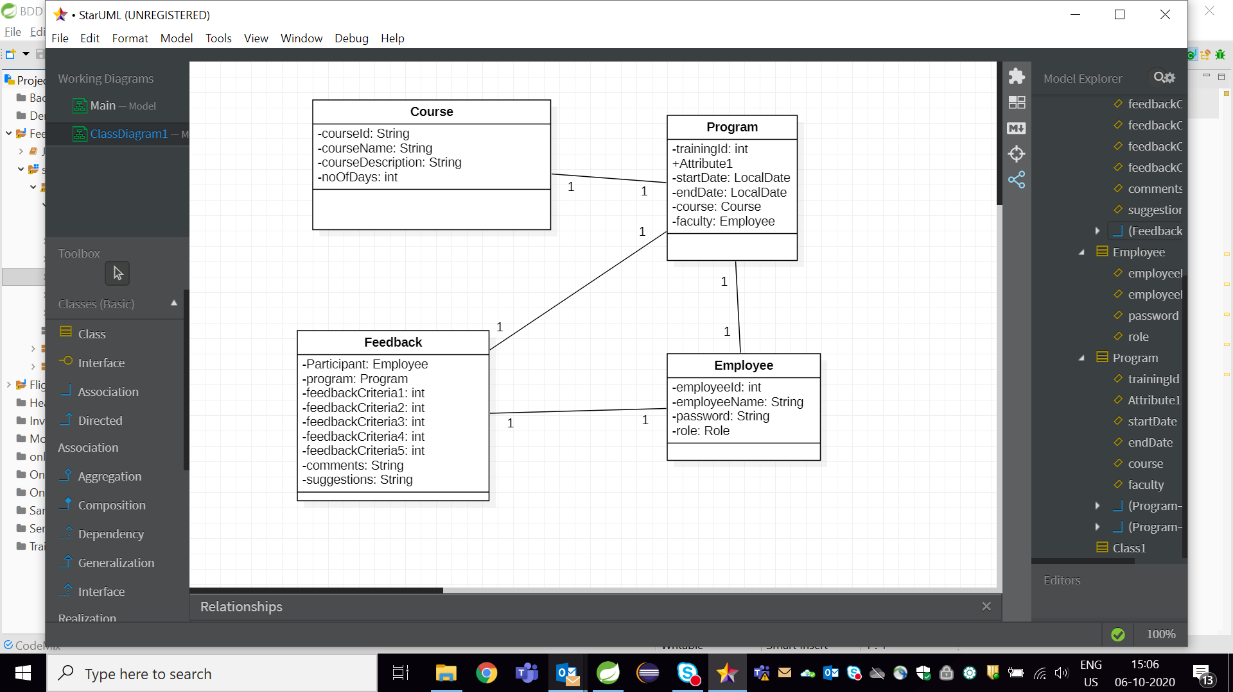
CLASS DESIGN

Slide 6
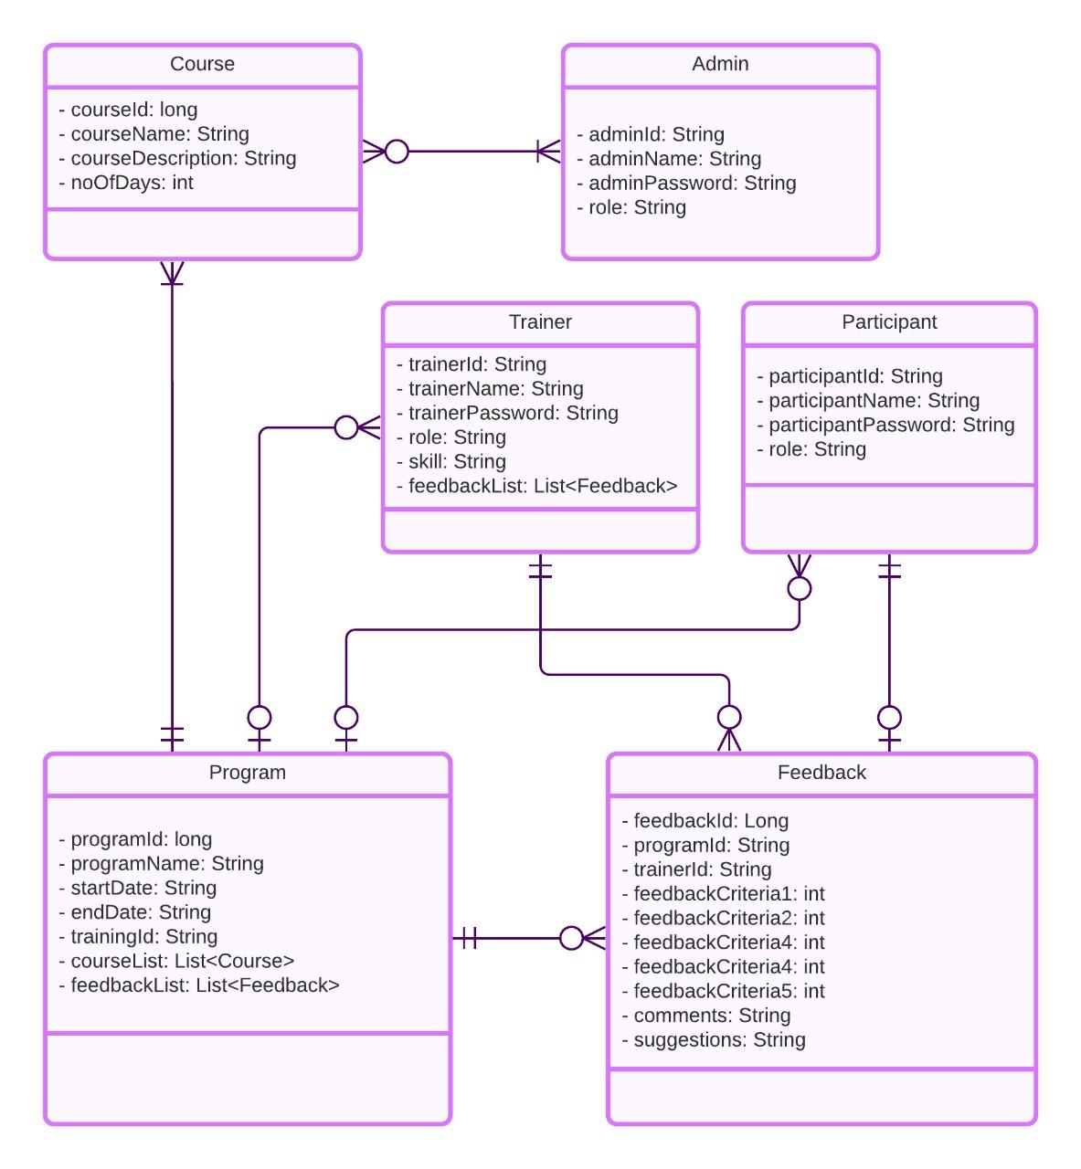
SCHEMA
DIAGRAM

Slide 7
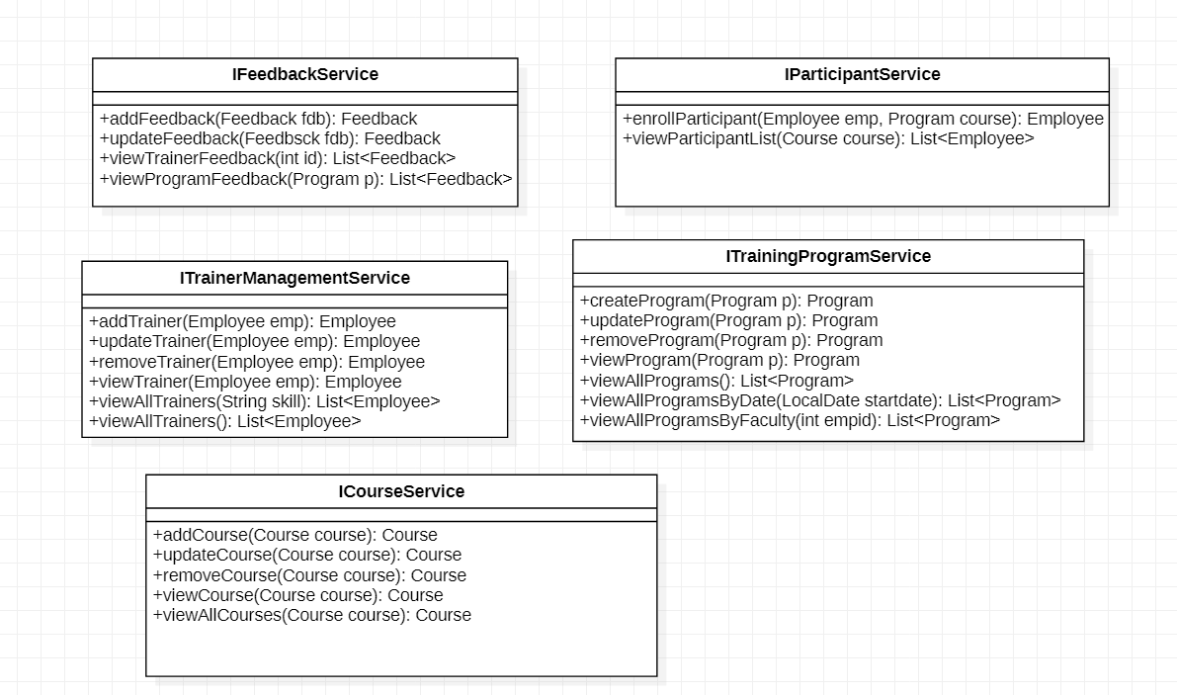
CLASS DESIGN
SERVICE —

Slide 8

CLASS DESIGN
REPOSITORY —

Slide 9
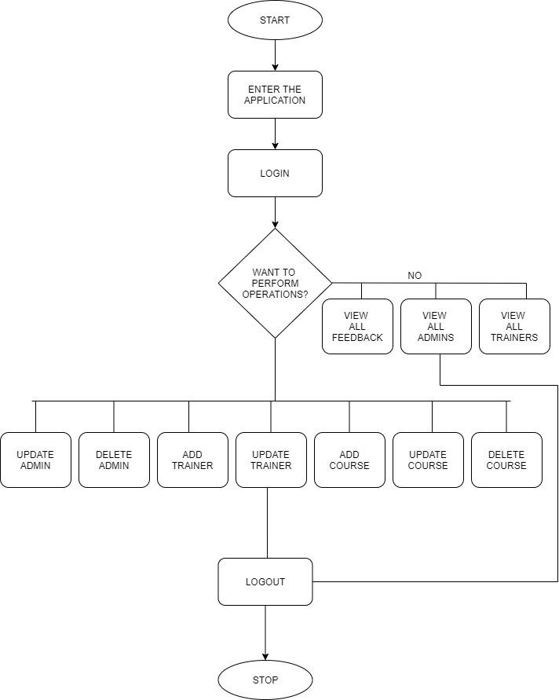
PROGRAM
FLOW
ADMIN

Slide 10
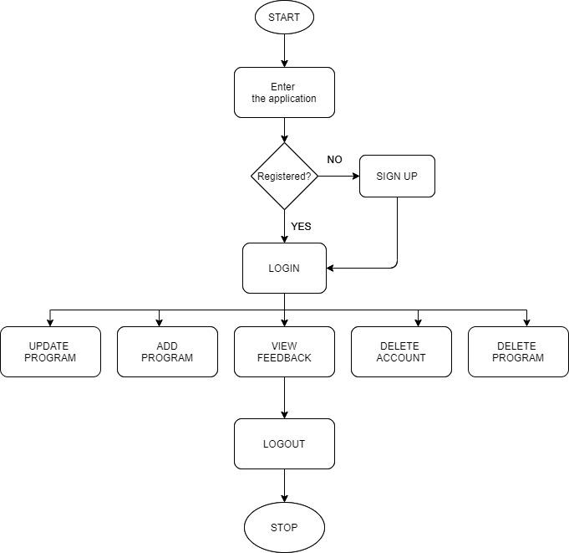
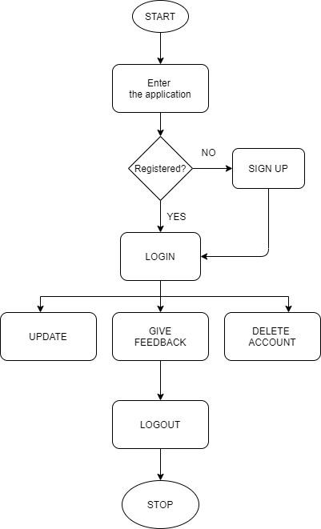
TRAINER
PARTICIPANT

Slide 11
CONCLUSION
In this project, we have implemented the concepts of Core Java 8, Spring, JPA, Hibernate as well as Oracle and have successfully created the application for Feedback Management System which can be used by any online education platform for managing their system.

Slide 12
THANK YOU !

